Slide 1

Week 5: Non-Linear Classification and Deep Learning
Part 1- Non-linear Classification
Dr Maha Saadeh

Slide 2
In this lesson … Part-1
Recall: Support vector classifier
Support vector machine

Slide 3
Support Vector classifier
When we use the soft margin to determine the position of the threshold, then this is a Support vector classifier
Dosage
These observations on the edge are called Support vectors ( remember that each observation is a vector of features) since they are supporting the selection of the threshold.

Slide 4
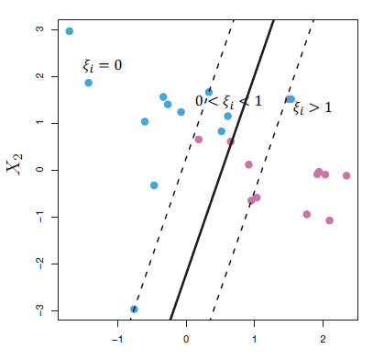
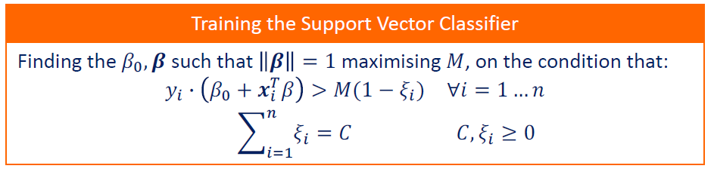
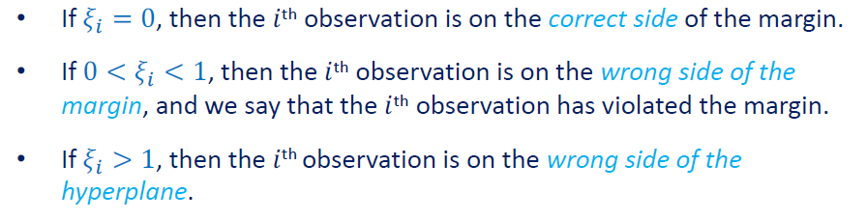
Support Vector
Support vector Classifier
Understanding the parameter
Observations inside the soft margin
Misclassified observations

Slide 5
Support Vector Machines
What to do if the problem is not linearly separable i.e. there is no hyperplane that can separate the different classes for the given observations
?

Slide 6
Support Vector Machines
Assume that we have the following 1D data that represent the dosage for a particular medicine. The blue color shows the class of patients who were cured after taking the dosage and the red not cured.
Dosage
No threshold can separate these observations into two classes
So, support vector classifiers do not work well with this type of data

Slide 7

Support Vector Machines
Solution: Try higher dimension
Dosage²
The x-axis is the original observations
The y-axis is the squared values
Now we have 2D data and a line (support vector classifier) which is successfully separating the classes
Dosage

Slide 8
Support Vector Machines
Solution: Try higher dimension
Dosage²
For any new observation, we take the square value and based on the support vector classifier, we can classify the observation. In this case, it is Blue
Dosage

Slide 9
Support Vector Machines
The main idea of SVM:
Start with low dimension (data dimension)
Try to find a support vector classifier, otherwise
Move the data to a higher dimension ( not Explicitly)
Dosage²
Dosage

Slide 10
Support Vector Machines
Dosage²
How to decide how to transform the data
?
Dosage

Slide 11
Support Vector Machines
How to decide how to move the data?
The SVM will use a kernel function to systematically find a support vector classifier in higher dimensions
It finds the support vector classifier as if the data were in that dimension, so it does not actually transform the data
Dosage²
This is called the Kernel Trick
Dosage

Slide 12
Support Vector Machines
Solution: Try higher dimension
Dosage²
In this example we use the polynomial Kernel
Other kernels
https://data-flair.training/blogs/svm-kernel-functions/#:~:text=SVM%20Kernel%20Functions&text=The%20function%20of%20kernel%20is,(RBF)%2C%20and%20sigmoid
Dosage

Slide 13
In this lesson … Part-1
Recall: The perceptron and Activation Functions
MLP
Feedforward and back propagation

Slide 14
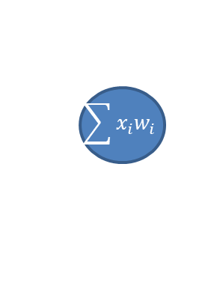
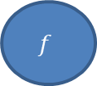
The Perceptron
The perceptron is a simple binary classification linear function that takes several inputs, sums them, and passes them through another function to give a single result.
w_{inew} = w_{iold} + α . e . x_{i}
Activation function
x₁
w₁
.
.
.
$$f$$
$$\sum{x_{i}w_{i}}$$
Y’
w_{m}
x_{m}
Y’ = f(Bias+ w₁ . x₁ + w₂ . x₂ + …+ w_{m} . x_{m} )
Y’ = f( b₀ + b₁ x₁ + ... + b_{m} x_{m} )
Bias

Slide 15
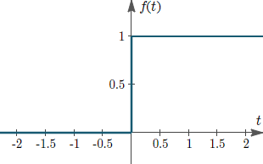
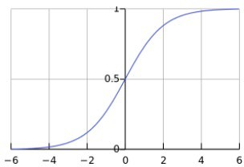
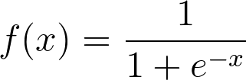
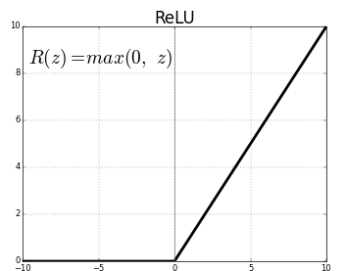
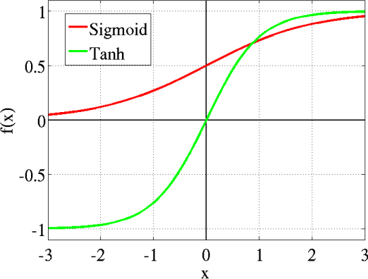


Activation Function
Step
Sigmoid
ReLU (rectified)
Tanh

Slide 16
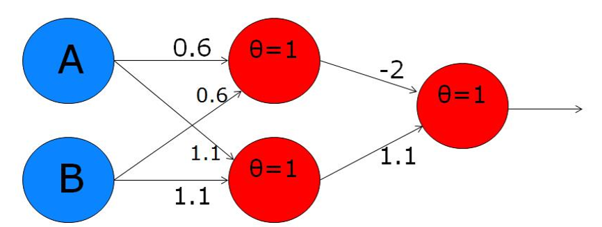
Multiple Layers Perceptron (MLP)

Slide 17
ANNs Learning
Feed forward backpropagation networks
Input layer
Hidden layer
output layer
x1
W₁₁
V₁₁
o1
h1
W₁₂
V₁₂
W₁₃
V₁₃
x2
o2
h2
n
x3
o3
h3

Slide 18
ANNs Learning
FFBP Learning (assume m is number of inputs, J is the number of hidden neurons , K is the number of output layer neurons)

Slide 19
ANNs Learning
Step 1: select random weights
Step 2: input the first input pattern [x1, x2, …, x_{m}]
Step 3: find the values from the hidden layer.
Input layer
Hidden layer
output layer
x1
W₁₁
V₁₁
o1
h1
W₁₂
V₁₃
V₁₂
W₁₃
x2
o2
h2
n
x3
o3
h3
Feed Forward

Slide 20
ANNs Learning
Step 1: select random weights
Step 2: input the first input pattern [x1, x2, …, xm]
Step 3: find the values from the hidden layer.
Step 4: find the output values.
Input layer
Hidden layer
output layer
x1
W₁₁
V₁₁
o1
h1
W₁₂
V₁₃
V₁₂
W₁₃
x2
o2
h2
n
x3
o3
h3
Feed Forward

Slide 21

ANNs Learning
Step 1: select random weights
Step 2: input the first input pattern [x1, x2, …, xm]
Step 3: find the values from the hidden layer.
Step 4: find the output values.
Step 5: find the error in the output layer. (t_{k} is the target output)
Input layer
Hidden layer
output layer
x1
W₁₁
V₁₁
o1
h1
W₁₂
V₁₃
V₁₂
W₁₃
o2
$$e_{ok}= \left(t_{k} − o_{k}\right)$$
x2
h2
n
x3
o3
h3

Slide 22
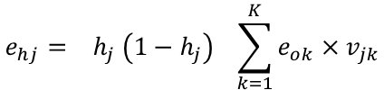
ANNs Learning
Step 1: select random weights
Step 2: input the first input pattern [x1, x2, …, xm]
Step 3: find the values from the hidden layer.
Step 4: find the output values.
Step 5: find the error in the output layer.
Step 6: find the error in the hidden layer.
$$e_{hj}= h_{j} \left(1−h_{j}\right) \sum_{k=1}^{K}{e_{ok}×v_{jk}}$$
Error
Input layer
Hidden layer
output layer
x1
W₁₁
V₁₁
o1
h1
W₁₂
V₁₃
V₁₂
W₁₃
x2
o2
h2
Back propagation
n
x3
o3
h3

Slide 23

ANNs Learning
Step 7: update the weights between the output layer and the hidden layer.
Input layer
Hidden layer
output layer
$$v_{jk}New=v_{jk}Old+ α × e_{ok} ×h_{j}$$
x1
W₁₁
V₁₁
o1
h1
W₁₂
V₁₃
V₁₂
W₁₃
x2
o2
h2
n
x3
o3
h3

Slide 24

ANNs Learning
Step 8: update the weights between the hidden layer and the input layer.
Input layer
Hidden layer
output layer
W₁₁
V₁₁
$$w_{ij}New=w_{ij}Old+ α × e_{hj} ×x_{i}$$
x1
h1
o1
W₁₂
V₁₃
V₁₂
W₁₃
x2
o2
h2
n
x3
o3
h3

Slide 25
ANNs Learning
Step 9: Repeat from step 2 using the next input sample .
Input layer
Hidden layer
output layer
x1
W₁₁
V₁₁
o1
h1
W₁₂
V₁₃
V₁₂
W₁₃
x2
o2
h2
n
x3
o3
h3

Slide 26
Python Exercise
SVM
MLP

